Slide 1
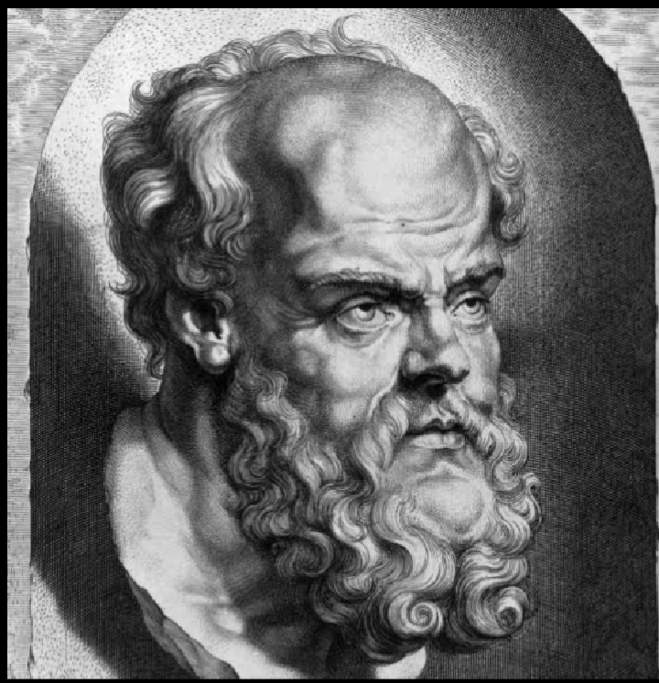
সক্রেটিস
(৪৭০-৩৯৯ খ্রীঃ পূঃ)
Theory of epistemology :
1.Knowledge is knowledge through concepts

Slide 2
Theory of Ethics :
Knowledge is virtue
Virtue is identical with knowledge
1.Virtue can be taught
2.Virtue is one

Slide 3
ধন্যবাদ

